Slide 1
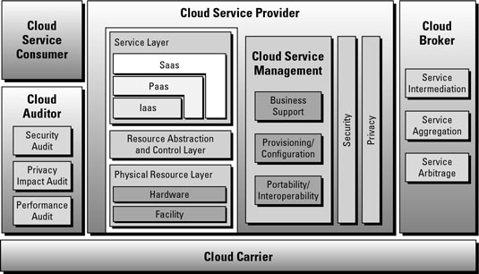
Cloud Architecture
Notes:
According to the official NIST definition, "cloud computing is a model for enabling ubiquitous, convenient, on-demand network access to a shared pool of configurable computing resources (e.g., networks, servers, storage, applications and services) that can be rapidly provisioned and released with minimal management effort or service provider interaction."

Slide 2
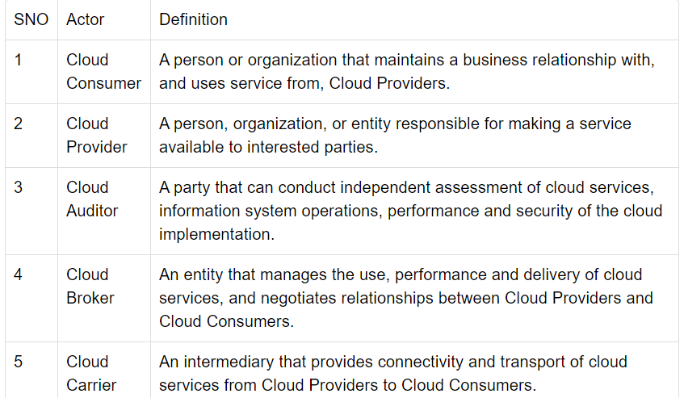

Slide 3
NIST
ACCESSIBILITY FROM DESKTOPS,PHONES
PHYSICAL LAYER-HARDWARE RESOURCES
ABSTRACTION LAYER-SOFTWARE DEPLOYED

Slide 4
Goal of NIST
Goal of NIST is to adopt secure & effective cloud computing to reduce cost and improve services.
Provide simple & unambiguous taxonomy of services
Software as a service(SaaS)
Platform as a service(PaaS)
Infrastructure as a service(IaaS)

Slide 5
Five essential characteristics of Cloud Architecture:
On-demand self-service
Broad network access
Resource pooling
Rapid elasticity or expansion
Measured service

Slide 6
Three service models according to Nist:
Software
Platform
Infrastructure

Slide 7
Four deployment models according to Nist:
Private Cloud
Public Cloud
Hybrid Cloud
Community Cloud

Slide 8
References:
https://www.nist.gov/news-events/news/2011/10/final-version-nist-cloud-computing-definition-published#:~:text=According%20to%20the%20official%20NIST,and%20released%20with%20minimal%20management

